Slide 1

PROJECT BASED LEARNING
PREDICTION OF SCHOOL DROPOUT
R Programming
CS 17.207
SUBMITTED BY:
NISTHA AGARWAL(170425)
SUBMITTED TO:
Mr. Sorabh Verma
1

Slide 2
R Programming
R is a programming language and free software environment for statistical computing and graphics supported by the R Foundation for Statistical Computing. The R language is widely used among statisticians and data miners for developing statistical software and data analysis. It provides, among other things, a programming language, high level graphics, interfaces to other languages and debugging facilities. Page fault and page hit, memory management logical and physical memory

Slide 3
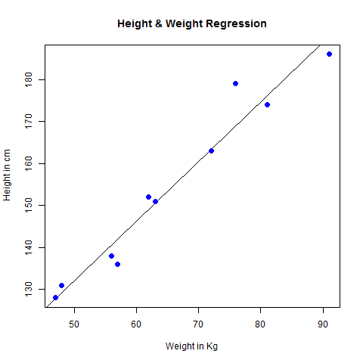
Machine Learning
Machine learning is the scientific study of algorithms and statistical models that computer systems use to effectively perform a specific task without using explicit instructions, relying on models and inference instead.
Regression Analysis
The use of mathematical and statistical techniques to estimate one variable from another especially by the application of regression coefficients, regression curves, regression equations, or regression lines.
As such, linear regression was developed in the field of statistics and is studied as a model for understanding the relationship between input and output numerical variables, but has been borrowed by machine learning. It is both a statistical algorithm and a machine learning algorithm.

Slide 4
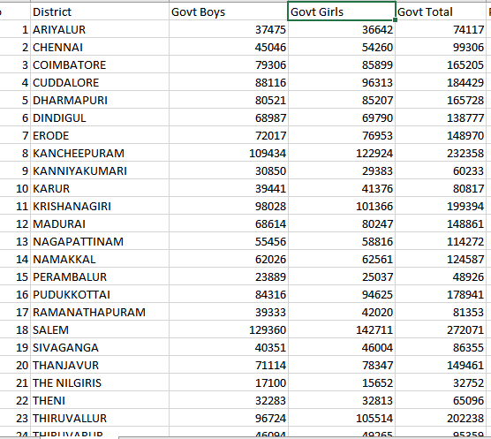
Our Project We will be taking the datasets from data.gov.in(an official data website by government of India) Record of Water facilities in different tiers of schools Record of Electricity in different tires of schools Record of Sanitation facilities By performing analysis of this data in R, we will be predicting dropout rate from schools estimating ranking of schools and performing regression analysis.
Example of Dataset

Slide 5
Thank You!

